Slide 1
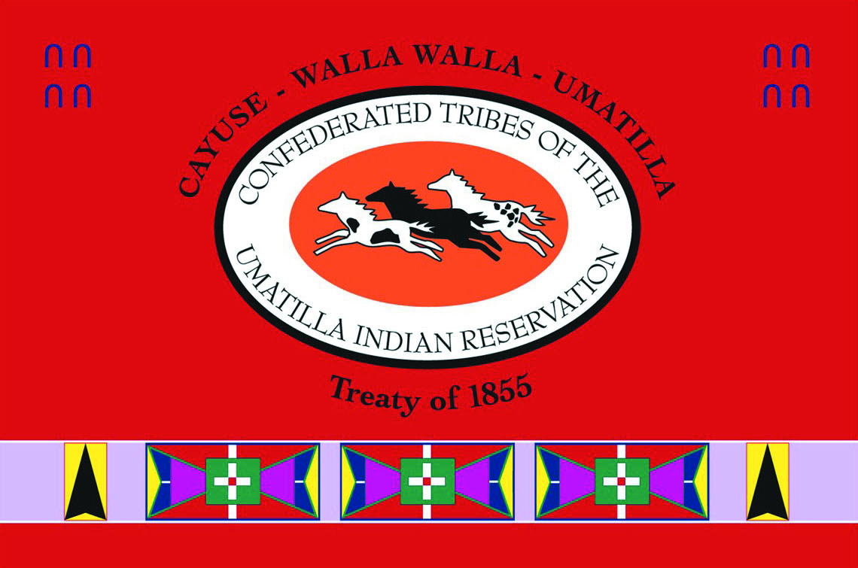
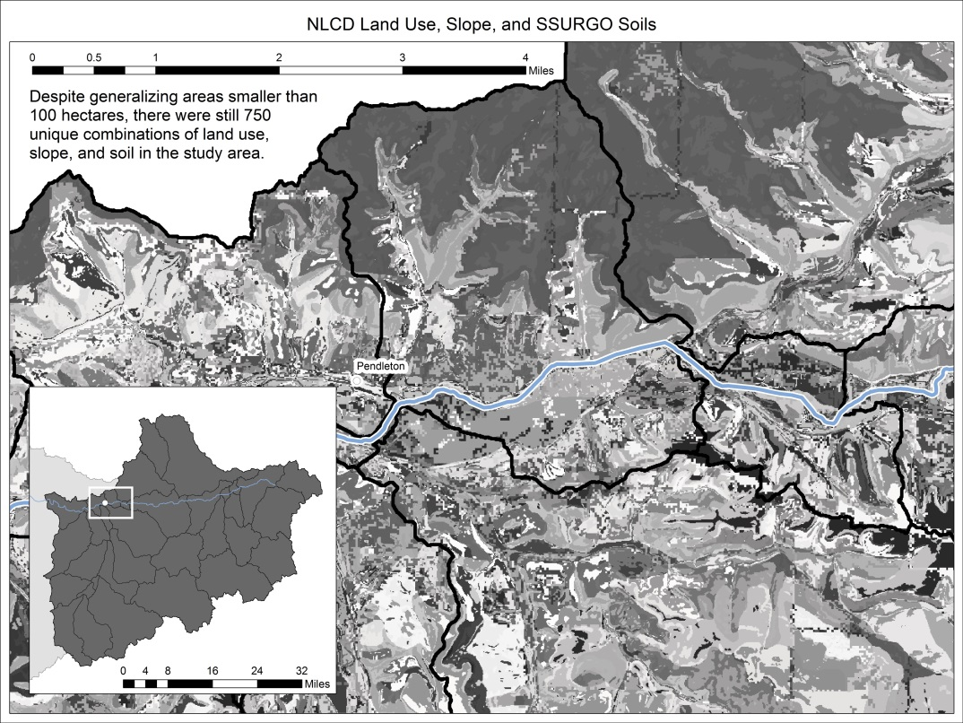
Confederated Tribes of the Umatilla Indian Reservation Program Project Semiannual Report Project: Future Flows Reporting Period: January through June 2017
Project Statement: To inform the management of the Umatilla River and its floodplain, through anticipated climate driven changes, we are conducting a spatially driven flow analysis informed by the CTUIR River Vision Touchstones. Current, generalized climate models predict that the Umatilla River floodplain will be subject to changing vegetation patterns, altered precipitation events, reduced base flows and increased peak flows. These changes are certain to impact the availability, quality and quantity of First Foods to the CTUIR community.
Project | Funding | ‘17 Budget | Total Staff
Inputs: | BIA | $58,105 | .75 FTE GIS Analyst
 | Staff: Bethy Rodgers-Pachico and Scott O’Daniel
Goals and Purpose: The overarching question that we ask is, “What is the character, extent and composition of Umatilla River floodplain and what changes should the Tribal community expect over the next several decades?”
Outputs (specific task accomplishments during the last 6 months):
Unique combinations of land cover, slope and soils have been created in a GIS format so that they can be used in the ARC-SWAT model (see Figure 1).
We have parameterized the ARC-SWAT flow model with both terrestrial and hydrologic data that has been the focus of several months of effort.
We have analyzed the spatial distribution of flow gages in the Umatilla River watershed and built a flow model on those that represent natural flows over the greatest area of the basin.
Outcomes (progress and trends resulting from outputs):
Initial model outputs show close correlation in modeled and measured flows.
Based on our work to date, we are preparing to give a series of talks within the CTUIR - to the Fish and Wildlife Committee, Water Commission .
We have an accepted abstract for a presentation the PNW Climate Conference in November , 2017.
Impacts (long-term accomplishments and vision):
Contribute knowledge to achievement of healthy watersheds (CTUIR River Vision) and increase traditional first food abundance and use opportunities.
Contribute to fulfilling the Subbasin Plan and ESA Recovery Plan goals.
Assist in recovery of Endangered Species Act subject species (chinook, summer steelhead, and, bull trout).
Address water quality limiting factors pursuant to the Clean Water Act - 303d list.
Figure 1. Gray shades in the larger image represent unique combinations of slope, land cover types and soils, combined as a model input for ARC-SWAT. The inset map, in the lower left corner, shows the analysis area for this effort. After analyzing the spatial distribution of flow gages in the Umatilla River watershed, we built a flow model on those that represent natural flows over the greatest area of the basin.
Notes:
1

